Slide 1
Azure API Management

Slide 2
Digital Transformation runs on APIs
Connected experiences
APIs
Services and data

Slide 3

API management solves API-related challenges
Discover
Learn
Get access
Try
SDKs and samples
Get help
Connected experiences
Abstract
Secure and protect
Manage lifecycle
Monitor and measure
Onboard developers
Monetize
Consume
Mediate
Publish
Developer portal
Gateway
Azure portal
APIs
Developers
(use APIs)
Publishers
(provide APIs)
Services and data

Slide 4
API Management
Demos

Slide 5
Product 1
Product 2
Product 3
Product 4
Product 5
API Store

Slide 6





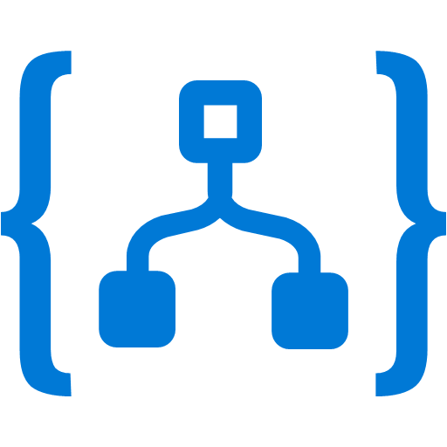


Product 1
Product 2
Product 3
Product 4
Product 5
API Management
Backends on Azure
Backends on premises

Slide 7
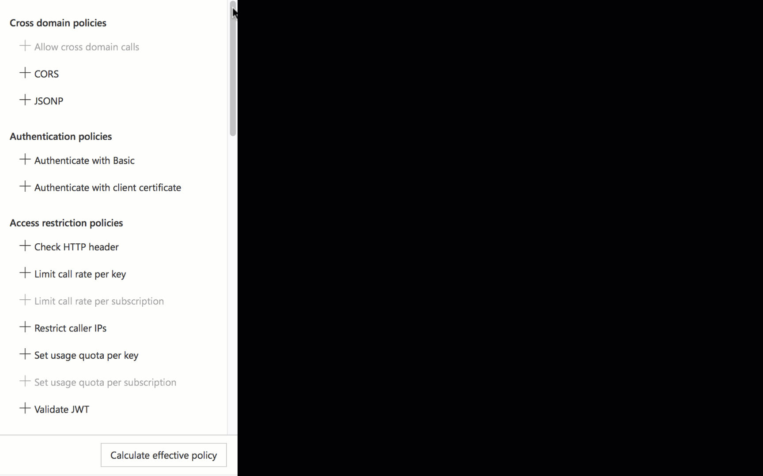
There is a policy for that
Encapsulate common API management functions
Access control, Protection, Transformation, Caching, …
Mutate request context or change API behavior
Add a header or throttle for example
Set in the inbound and outbound directions
Applied at a variety of scopes or on error
Scope determines which APIs are affected
Can define custom scopes in addition to four available b default
Composed into a pipeline from effective scopes
Degree of control over inheritance of scopes, i.e. <base/> element
Don’t delete <base/> inadvertently
http://aka.ms/apimpolicyexamples

Slide 8
Policy scopes
GET /foo/bar HTTP/1.1
Host: api.constoso.com
Key: 0123456789
global
CORS
LOG
0123456789
product
from caller
RATE
QUOTA
inbound
to backend
/foo
api
JWT
/bar
operation
CACHE
URL
BODY
to caller
from backend
outbound

Slide 9
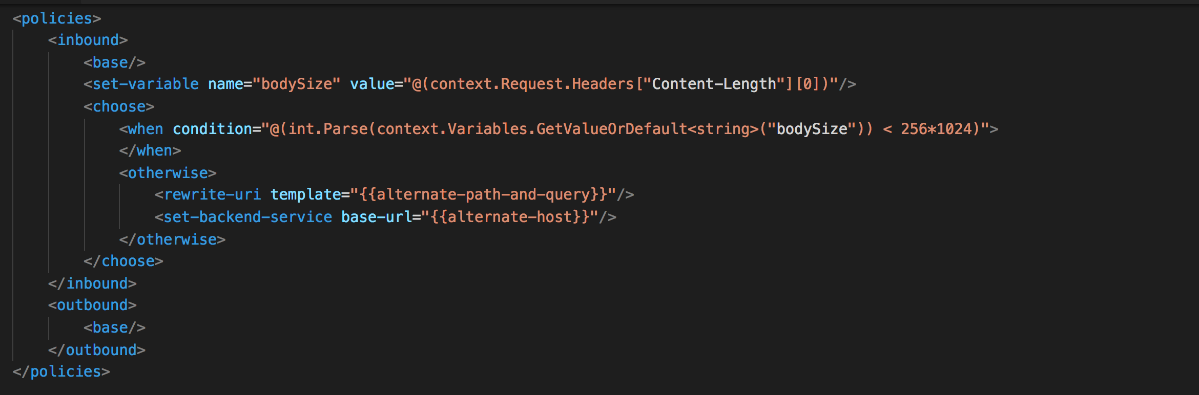
Policy expressions
Named values
C# “snippets” used with policies
Read-only access to the request context
Can use whitelisted .NET types
Dynamically configure and conditionally execute policies
Shared across APIM instance
Keep secrets and “magic” strings out of policies
Add semantics, if named well
Enable a single point of change
Provide environment-specific values

Slide 10
API Management
Demos: Versions and Revisions

Slide 11
Use Revisions when
You make a non-breaking change to your API
You want to make changes safely
You may want to roll-back your changes
You want to give your developer community details of your changes

Slide 12
Use Versions when
You need to show developers a relationship between APIs
You need to give developers a predictable way to switch between related APIs
You want to add breaking changes
You want to try out changes and solicit feedback from your community

Slide 13
API Management and Security

Slide 14


Security and protection
Username/Password
Internet IPs
Microsoft account
Google account
Facebook account
Twitter account
Delegated (custom)
Azure AD
Azure AD B2C
Developer portal
App developers
Consume
Key
OAuth 2 & OpenID Connect
Client certificate
Custom external authorizer
IP filter
Rate limits and quotas
Gateway
HTTP Basic
Mutual certificate
Shared secret
IP filter
VNET/NSG
Mediate
1st and 3rd party apps
Azure portal
Azure account
RBAC
APIs on Azure and outside
Publish
API publishers

Slide 15



VNETs and Hybrid
Developer portal
Consume
App developers
VNET
Gateway
Mediate
1st and 3rd party apps
Azure portal
Publish
APIs on Azure and outside
API managers and developers

Slide 16



VNETs and Hybrid
VPN
VNET
Gateway
Mediate
1st and 3rd party apps

Slide 18
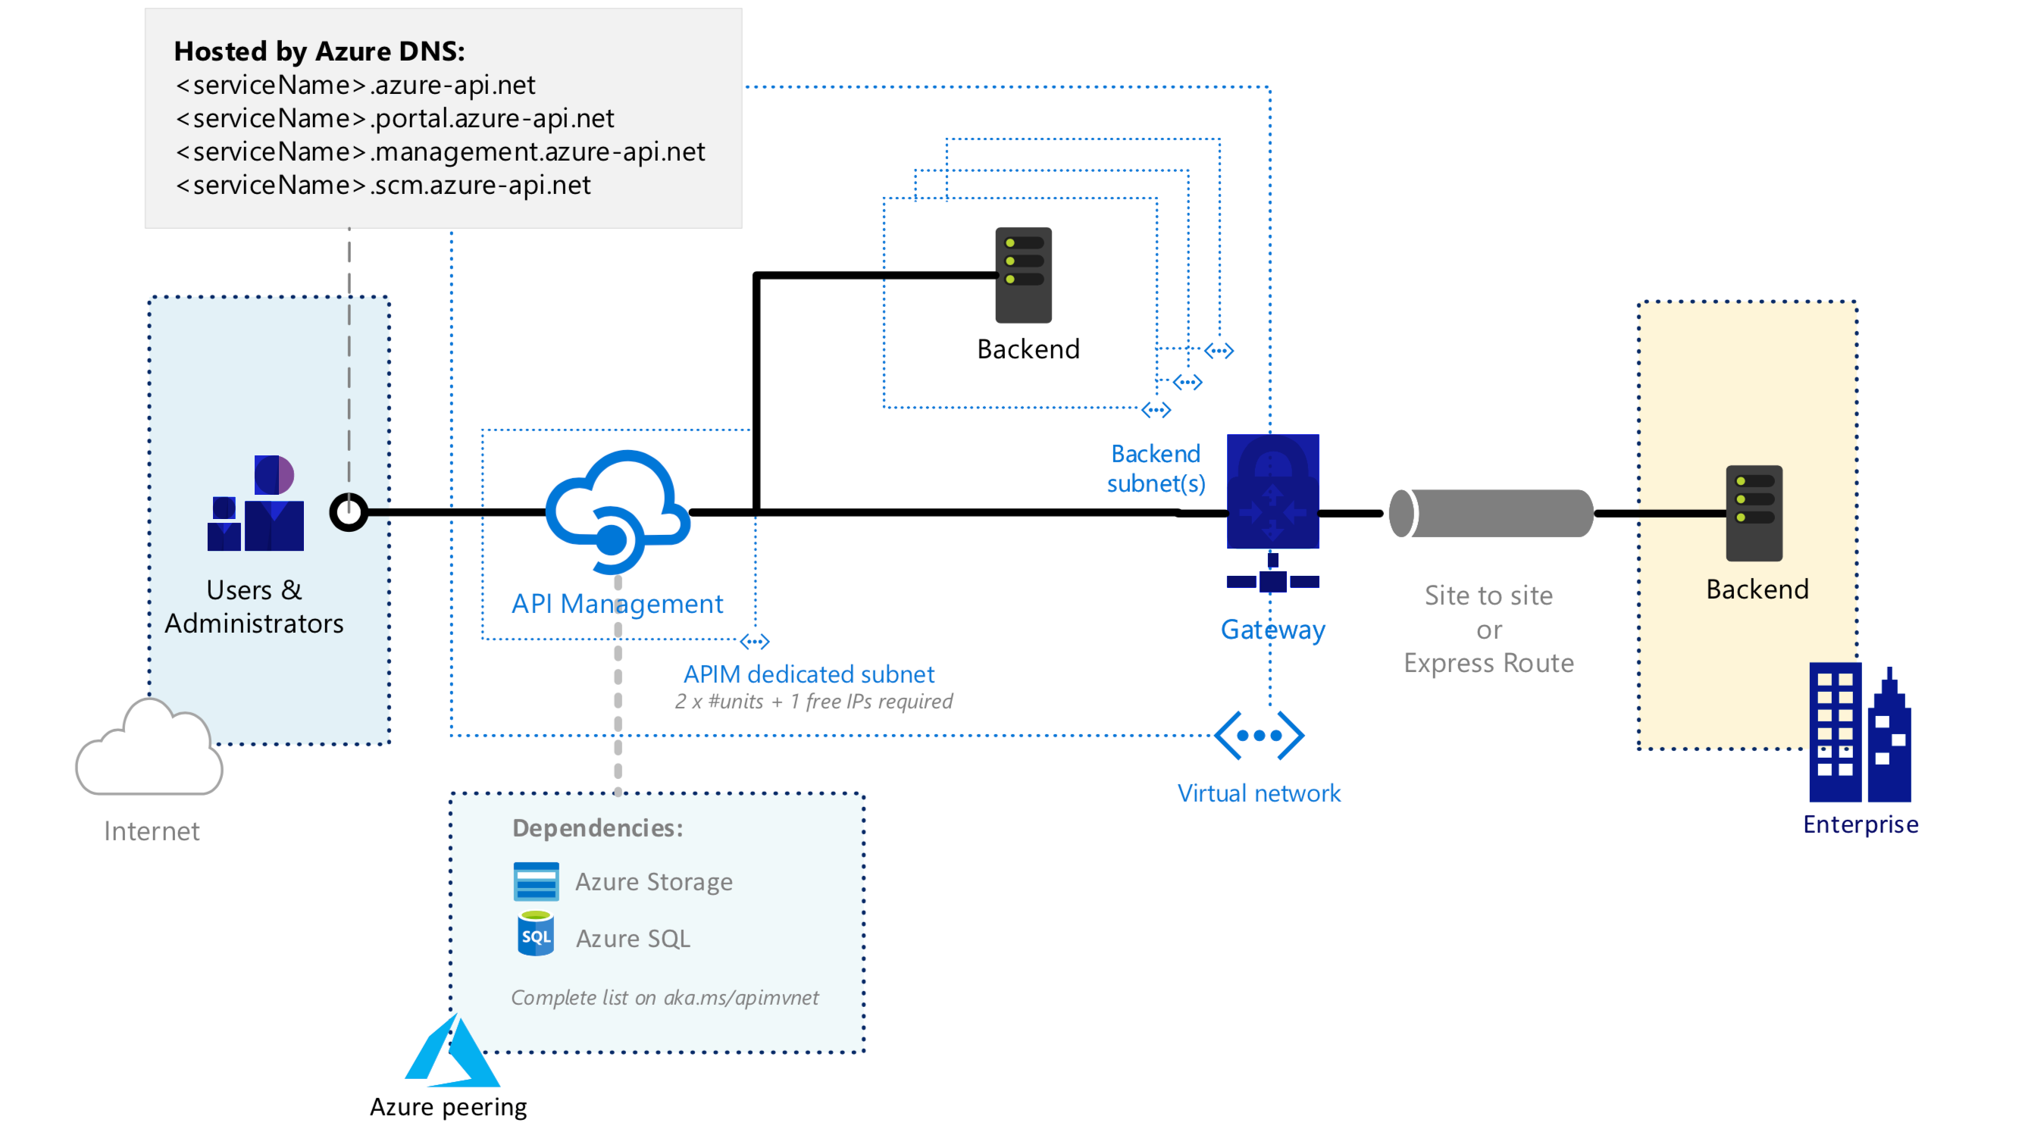
External configuration
Secure external access to private cloud and on-premises endpoints

Slide 19
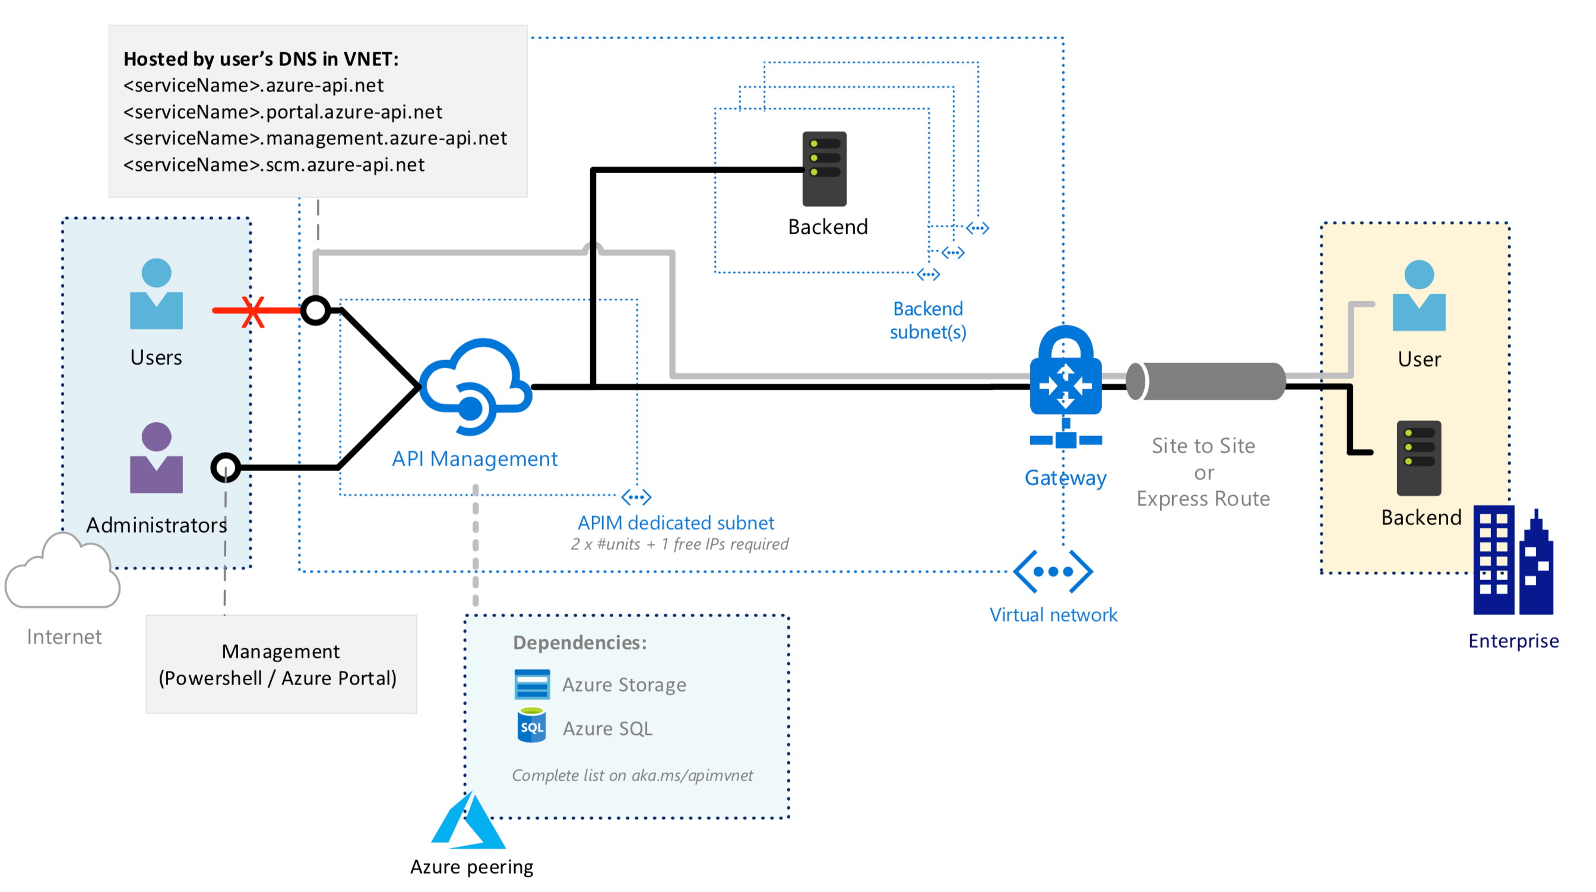
Internal configuration
Secure internal access to private cloud and on-premises endpoints

Slide 20
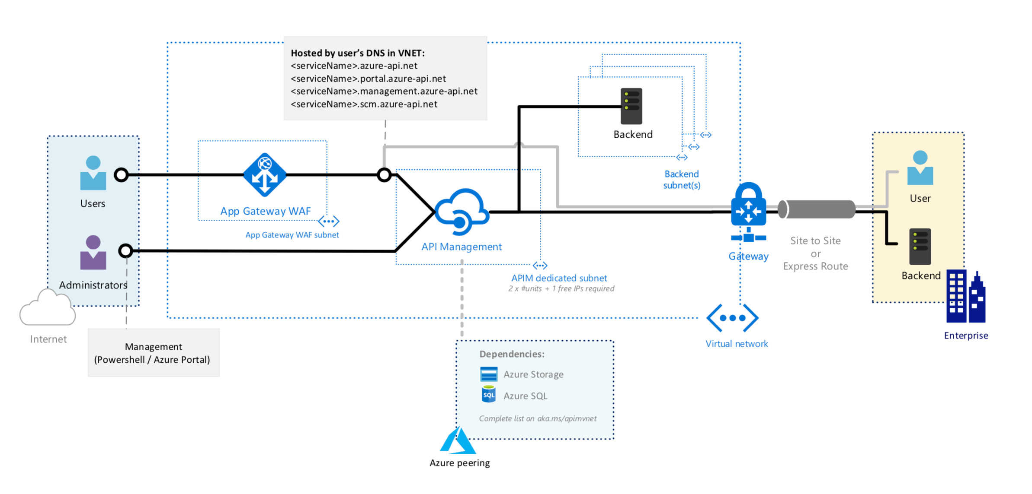
Internal configuration with a WAF
More secure external access to private and on-premises endpoints
Secure internal access to private cloud and on-premises endpoints

Slide 21
Key vs JWT
 | Key | JWT
Credential type | Bearer | Bearer
Token type | Reference | Self-contained
Sensitivity | Is a secret | Doesn’t contain secrets
Expiration | External, ad hoc | Built in, pre-defined
Subject | Developer and an app | End user or an app

Slide 22

Regional availability
30 public regions in Americas, Europe, Asia and Australia
6 US Government regions and 2 regions in China

Slide 23

Multi-region topologies

Slide 24

Multi-region topologies
Secondary
region
Primary
region

Slide 25
Multi-region topologies
Secondary
region
Primary
region

Slide 26
Multi-region topologies
Secondary
region
Primary
region
Shared state
Hint: use <choose> to <set-backend> policy based on context.Deployment.Region

Slide 27
Multi-region topologies
Secondary
region
Primary
region
Shared state

Slide 28
Multi-region topologies
Secondary
region
Primary
region
Shared state

Slide 29

Multi-region topologies – custom TM
Secondary
regions
Primary
region
Secondary
region
Shared state
Shared state

Slide 30
We just scratched the surface
40 policies - security, transformations, traffic management, extensibility
API publishing with products, users and groups
VNET support for external and internal use cases
Multi-region deployment topologies for high-availability and performance
Azure Monitor metrics, logs and alerts
Analytics and Power BI template
Azure AD and Azure AD B2C integration
Developer portal customization
SOAP and SOAP2REST
…

Slide 31
NEW API Management tier – “Consumption”
API management layer for microservice-based architectures
Serverless properties
Instant provisioning
Automated scaling - out and back to zero
Built-in high availability
Per action pricing
Curated feature set, e.g.
No developer portal
Bring your own response cache
Usage limits

Slide 32
Stay in touch
Questions and discussions | http://aka.ms/apimso
Service updates, among other things | http://aka.ms/apimblog
GitHub repo with sample policies | http://aka.ms/apimpolicyexamples
Tutorial, documentation, and references | http://aka.ms/apidocs
Feedback and feature requests | http://aka.ms/apimwish
Roadmap | http://aka.ms/apimroadmap
Customer stories | http://aka.ms/apimcustomers

